Slide 1
By: Deepak Munjal B00748375
Finding the Best Dish of a Restaurant using NLP Techniques
CSCI 6509

Slide 2
Problem Statement
To find the best dish of a restaurant by doing sentiment analysis of the user reviews.
User reviews are analyzed using different Natural Language Processing Techniques
Each model created, is evaluated using multiple factors.
Best dish is predicted for each restaurant.

Slide 3
Motivation
The motivation behind this is the importance of the user reviews for a restaurant on a business level.
The solution to this problem statement can provide the restaurants with crucial information from the user point of view.

Slide 4
Related Work
Thumbs up? Sentiment Classification using Machine Learning Techniques
Bo Pang and Lillian Lee, Department of Computer Science, Cornell University
Shivakumar Vaithyanathan, IBM Almaden Research Center
Picking Out Good Dishes from Yelp
Angela Gong and Jennifer Lu, Stanford University

Slide 5
Steps followed/Approach-
Scraping restaurant review data from website www.yelp.ca
Manual labeling of data i.e. positive or negative class.
Labeling of dish names for each review.
Sentiment analysis using various techniques
Prediction of best dish names

Slide 6
Scraping from Yelp-
Scraping of Restaurant reviews is done using Beautiful Soup, a python library for scraping HTML WebPages.
Restaurant Yelp URL, name and user reviews are extracted for each restaurant and are then saved in a CSV file.

Slide 7
Preprocessing of Data-
Punctuation marks, special symbols etc are removed from review.
conversion into lowercase is done.
Stopwords are removed from the review.
Stemming is applied.
Data is divided into training and test data

Slide 8
Various Classifiers used-
Bag of words with positive and negative list of words.
random forest with character trigrams
random forest with word trigrams
Naïve Bayes with character trigrams
Naïve Bayes with word trigrams

Slide 9
Bag of words with positive and negative list of words.
Each review is converted into bag of words.
These words are matched with the list of positive and negative words, taken from online resources.
Based on count of positive and negative words in each review, it is classified as positive or negative.
Then based on these classes, best dish of each restaurant is predicted.

Slide 10
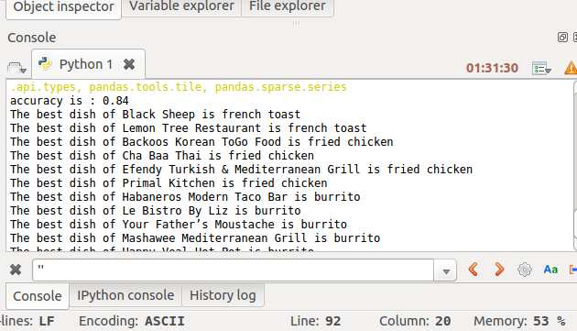
Screenshot-

Slide 11
random forest with character trigrams
Each review is converted into character trigrams.
The list of all unique character trigrams are taken as feature set.
Term document matrix is created.
Random Forest Classifier is applied.
Model is evaluated.

Slide 12
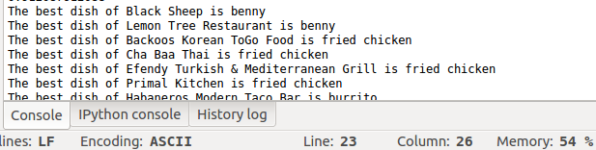
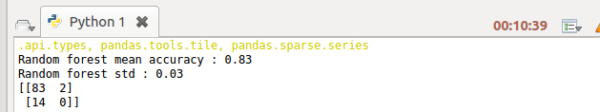
Screenshot-

Slide 13
random forest with word trigrams
Each review is converted into word trigrams.
The list of all unique word trigrams are taken as feature set.
Term document matrix is created.
Random Forest Classifier is applied.
Model is evaluated.

Slide 14
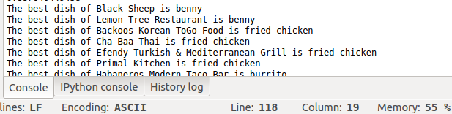

Screenshot-

Slide 15
Naïve Bayes with character trigrams
Each review is converted into character trigrams.
The list of all unique character trigrams are taken as feature set.
Term document matrix is created.
Naïve Bayes Classifier is applied.
Model is evaluated.

Slide 16
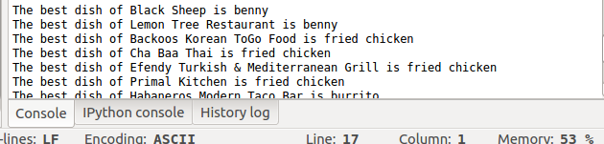
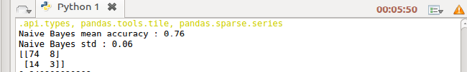
Screenshot-

Slide 17
Naïve Bayes with word trigrams
Each review is converted into word trigrams.
The list of all unique word trigrams are taken as feature set.
Term document matrix is created.
Naïve Bayes Classifier is applied.
Model is evaluated.

Slide 18
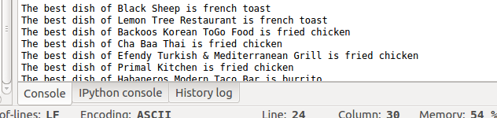
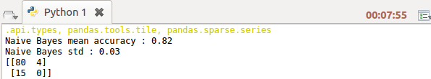
Screenshot-

Slide 19
Conclusion-
Random Forest with word trigrams has maximum accuracy for this case.
Best dish of each restaurant is predicted.

Slide 20
Future Possibilities-
Few more Classifier techniques can be applied and evaluated.
Algorithm complexity of the code can be analyzed to see possibilities of improvement.
Sentiment analysis can be done on partial sentences in the reviews.
Unigrams or Bigrams can be considered.

Slide 21
Thank You!!

